Slide 1

Alert & Pop UP

Slide 2
Introduction
Alert is a small message box which displays on-screen notification to give the user some kind of information or ask for permission to perform certain kind of operation.
Alert will not allow any action on the underlying webpage if they are present.
A window that suddenly appears (pops up) when you select an option with a mouse or press a special function key.
The pop-up window contains a menu of commands and stays on the screen only until you select one of the commands.

Slide 3
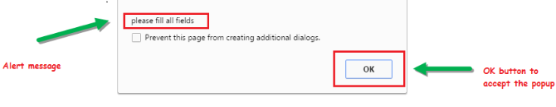
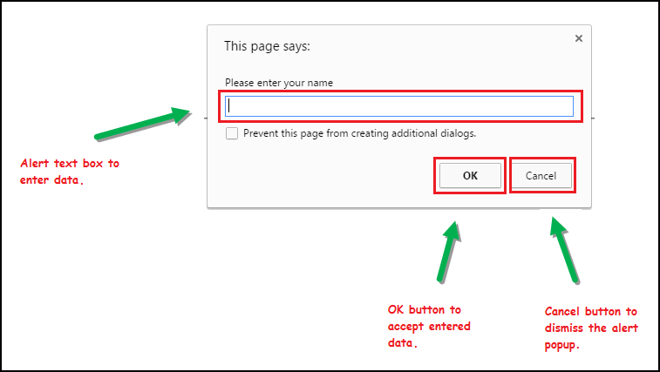
Types of Alert
Simple Alert:-This simple alert displays some information or warning on the screen and just have a OK button on them.
2) Prompt Alert:-
This Prompt Alert asks some input from the user and selenium webdriver can enter the text using sendkeys.

Slide 4
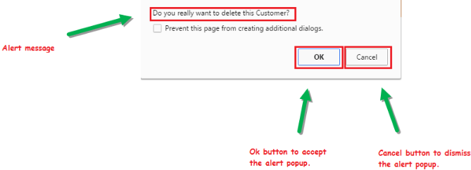
3) Confirmation Alert:-This confirmation alert asks permission to do some type of operation Like accept or dismiss the alert.

Slide 5
Alert Methods
switchTo():-This method used for switch to alert from the main window.
Method | Method Detail | Description
void accept() | driver.switchTo().alert().accept() | To accept the alert or click on the 'OK' button of the alert
void dismiss() | driver.switchTo().alert().dismiss() | To accept the alert or click on the 'Cancel' button of the alert.
String getText() | driver.switchTo().alert().getText() | To get the text of the alert.
void sendKeys(String stringToSend) | driver.switchTo().alert().sendKeys("Text") | To write some text to the alert.

Slide 6
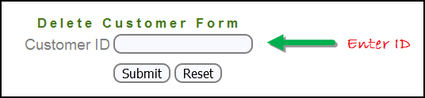
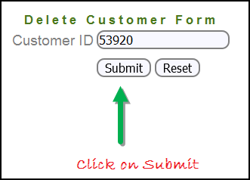
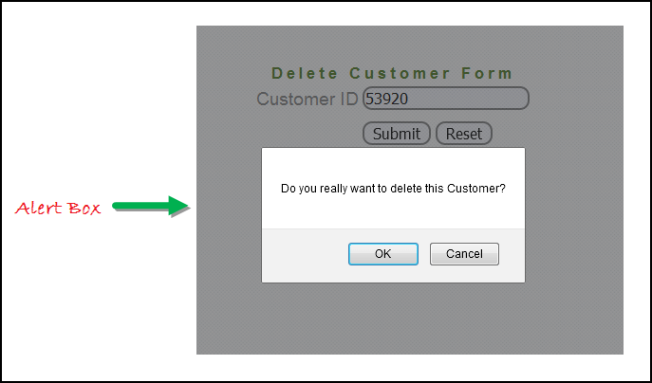
How to Implement
See below Example:-
Launch the web browser and open the site(Base Url).
Enter any Customer ID.
After entering the customer ID, Click on the "Submit" button.
Reject/accept the alert.

Slide 7
Now see the code here:-
import org.openqa.selenium.By;
import org.openqa.selenium.WebDriver;
import org.openqa.selenium.chrome.ChromeDriver;
import org.openqa.selenium.NoAlertPresentException;
import org.openqa.selenium.Alert;
public class AlertDemo {
public static void main(String[] args) throws NoAlertPresentException,InterruptedException { System.setProperty("webdriver.chrome.driver","G:\\chromedriver.exe");
WebDriver driver = new ChromeDriver();
driver.get(“BASE URL");
driver.findElement(By.name("cusid")).sendKeys("53920");
driver.findElement(By.name("submit")).submit();
Alert alert = driver.switchTo().alert(); // Switching to Alert
String alertMessage= driver.switchTo().alert().getText(); // Capturing alert message.
System.out.println(alertMessage); // Displaying alert message
Thread.sleep(5000);
alert.accept(); } } // Accepting alert

Slide 8
Handling Pop Window
when multiple windows in any web application, the activity may need to switch control among several windows from one to other in order to complete the operation. After completion of the operation, it has to return to the main window in automation i.e. parent window.
There are two methods through which can handle multiple windows:-
1)getWindowHandles():-
To handle all opened windows by web driver or switch window from one window to another in a web application.
Its return type is Iterator<String>.
2)getWindowHandle():-
To handle the main window by this method.
Its return type is String.

Slide 9
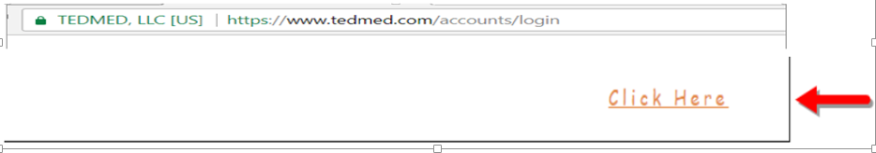
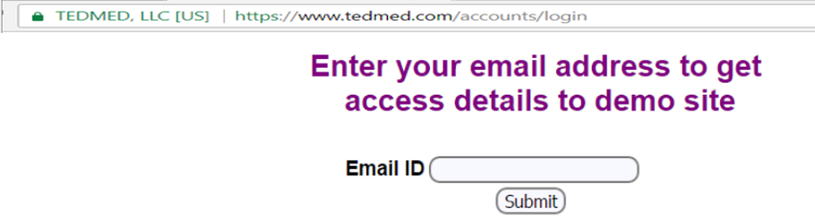
How to Implement
See below Example:-
Launch the web browser and open the site(Base Url).
When the user clicks on the " Click Here " link, new child window opens.
A new window opens, ask the user to enter email id and submit the page.

Slide 10
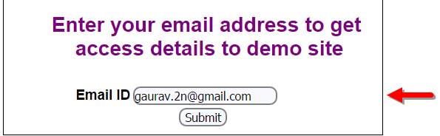
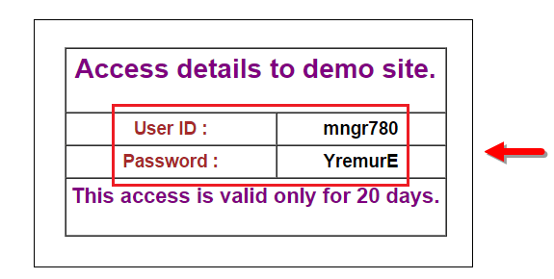
4) Enter your email ID and submit.
5) Display the Access Credentials on submitting the page.
When execute the code, child window is open in new tab.
Close the Child window on which credentials are displayed.
Switch to the parent window.

Slide 11
import java.util.Iterator; import java.util.Set; import org.openqa.selenium.By; import org.openqa.selenium.WebDriver; import org.openqa.selenium.firefox.FirefoxDriver; public class WindowHandle_Demo { public static void main(String[] args) throws InterruptedException { WebDriver driver=new FirefoxDriver(); driver.get(“BASEURL"); //Launching the site. driver.manage().window().maximize(); driver.findElement(By.xpath("//*[contains(@href,'popup.php')]")).click(); String MainWindow=driver.getWindowHandle(); Set<String> s1=driver.getWindowHandles(); // To handle all new opened window. Iterator<String> i1=s1.iterator(); while(i1.hasNext()) { String ChildWindow=i1.next(); if(!MainWindow.equalsIgnoreCase(ChildWindow)) {driver.switchTo().window(ChildWindow); // Switching to Child window driver.findElement(By.name("emailid")) .sendKeys("gaurav.3n@gmail.com"); driver.findElement(By.name("btnLogin")).click(); driver.close();} } // Closing the Child Window. driver.switchTo().window(MainWindow); // Switching to Parent window i.e Main Window. } }
Now see the code here:-

Slide 12
Covered Till Now
We defined the types of alert and shown them with a screen shot.
Demonstrated handling the Alert with Selenium.
Handled multiple windows with Selenium WebDriver.

Slide 13
Thanks

